Slide 1

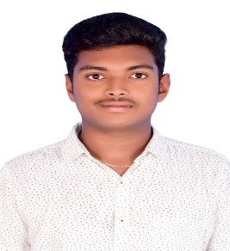
MANOJ SAI PENUGONDA
Advanced App Engineering Analyst Level-11
Accenture
Mobile: + 91- 7095258282
Email: manoj.sai.penugonda@accenture.com
Location: Chennai
Relevant Experience
Project Experience: Pfizer, Application Developer(SEP 2024 – PRESENT)
Assigned Role: Advanced App Engineering Analyst
Technology : ReactJS, CSS, HTML and SASS
Contributed to enhancement of Pfizer web application by implementing new features using React, CSS, and SASS, improving UI performance and user experience.
Developed and maintained a data analytics application using React.js, implementing dynamic charts and tables to display various ticket data for real-time insights.
Handled deployment processes on Linux servers using Apache Tomcat, JAR files, and Nginx, ensuring smooth delivery, server configuration, and performance optimization in production environments.
Project Experience: Unilever, Application Developer(JAN 2023 – AUG 2024)
Assigned Role: Advanced App Engineering Analyst
Technology : ReactJS, CSS, HTML and Byte Platform
Performed the role of full – stack frontend developer using React, SQL.
Created data analytic application for client using the byte Platform.
I have worked on developing the application using ReactJS and Configs.
I have worked on CSS properties of the application which include Ag Grid, Bar chart components.
I have created and worked on the Key Performance Indices(KPI) creation and widget configuration using KPI’s and Configs.
Background
I am an Advanced App Engineering Analyst trained on MERN stack, mainly on Mongo Db, Express, React and Node JS.
I am also proficient in Python, SQL and have moderate knowledge on Core Java.
I hold a Bachelor’s degree in Electronics Engineering from Madras Institute of Technology, Anna University, Chennai.
Worked on Web Applications Development using ReactJS and Java Script.
Skills:
React
Java Script
HTML and CSS
Python
SQL
Tools :
VS Code
Postman
MongoDB
Workbench
Copyright © 2025 Accenture. All Rights Reserved. Proprietary and Confidential Information to Accenture.

